Slide 1

Customer segmentation using Machine Learning
SHRI RAMDEOBABA COLLEGE OF ENGINEERING AND MANAGEMENT
Department of Information Technology
Sem-VIII (2021-22)
Project Seminar on
By
Abhishek Verma (26)
Deepanshu Sahu (34)
Laxmikant Kabra (47)
Under the guidance of
Prof. P. J. Assudani
Professor, Dept. of Information Technology, RCOEM, Nagpur

Slide 2
Contents
Sr. no. | Index
1. | Introduction
2. | Literature review/Existing method
3. | Methodology
4. | Advantages
5. | Timeline
6. | References

Slide 3
Introduction
Machine Learning and python can be used in a simplistic way to fuel a company’s growth by applying the predictive approach to various actions.
All customers can’t be treated with same methods of promotion, communication etc.
So, one can make dynamic choices that could benefit the business. To do this, it is necessary to segment customers in various categories which can facilitate better decision making.
By a combination of programming, data analysis, and machine learning can bring highly promising results that can fetch benefit to a business.

Slide 4
Literature Review/ Existing Methods
Sr. no | Title(author) | Journal | Description
1. | Review on Customer Segmentation Technique on Ecommerce (Sari, Juni Nurma, et al.) | Journal of Computational and Theoretical Nanoscience | Used RFM technique to depict a segmentation model. But only theoretical approach has been given and no practical implementation has been conducted or proposed.
2. | Customer Segmentation using Machine Learning (A. Banduni, Ilavendhan) | International Journal of Creative Research Thoughts (IJCRT) | Customer segmentation is done using K-Means and elbow criterion method. Imbalanced dataset was used. Result are not documented properly.
3. | A Systematic Approach to Customer Segmentation and Buyer Targeting for Profit Maximization (Bhade, Kalyani, et al.) | IEEE Xplore | Used K-Means clustering for customer segmentation and Singular Value Decomposition is used for providing appropriate recommendations to the customers.

Slide 5
Literature Review/ Existing Methods
Sr. no | Title(author) | Journal | Description
4. | RFM ranking–An effective approach to customer segmentation (Christy, A. Joy, et al.) | Science Direct | RFM analysis technique was used for segmentation. K-means and Fuzzy C-Means were implemented and concluded K-Means as a better choice of algorithm.
5. | How to strengthen customer loyalty, using customer segmentation (Elena Lidia) | Bulletin of the Transilvania University of Braşov Series V: Economic Sciences | This paper provides a prerequisite for customer segmentation dataset based on customer satisfaction, recommendation and future expectation.
6. | Customer Segmentation using Machine Learning (Monil, Patel) | International Journal for Research in Applied Science and Engineering Technology (IJRASET) | This paper talks about dividing a market into different buyers with different behaviors by usage of CRM as part of the organizations business strategy for enhancing customer service satisfaction by using different types of clustering algorithm like Affinity Propagation Algorithm, Density Based Clustering, etc.

Slide 6
Methodology
We have used a sample dataset of an online retail. For an online retail, we selected monthly revenue, monthly active customers, monthly order count or average revenue per order are a few useful metrics.
This information can be used to gain insights into customer behavior and therefore we could segment customers.
RFM – Recency-Frequency-Monetary value; technique will be used for segmentation.
0 to 2: Low Value
3 to 4: Mid Value
5+: High Value
K-Means analysis, Xtreme Gradient boosting classifier were used in our model implementation.

Slide 7
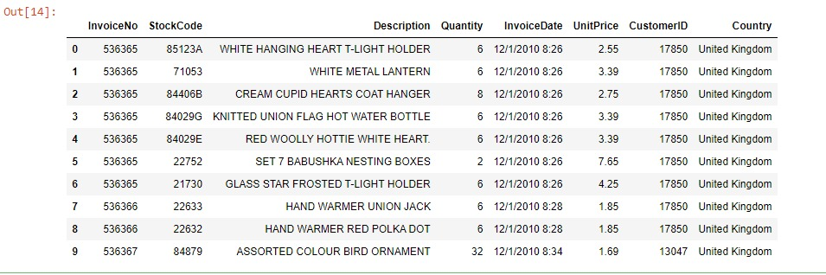
Methodology – Module 1
Dataset was gathered from Kaggle website.

Slide 8
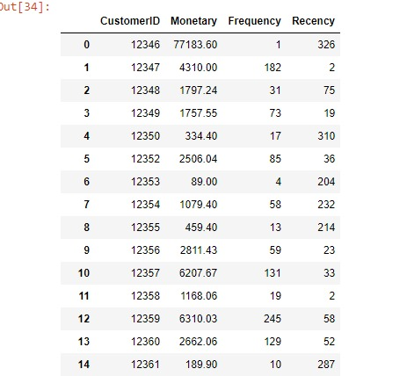
Methodology – Module 1
The data was pre-processed.
Cancelled invoices removed
Duplicate invoices removed
Null entries removed
Then we calculated RFM values:
Recency based on difference between last invoice date and current invoice date
Frequency based on number of transactions made by each customer
Monetary based on sum of total billing of all transactions for each customer

Slide 9
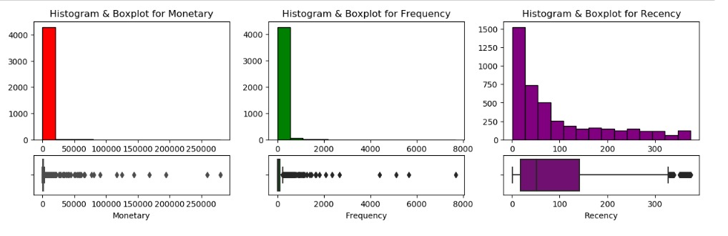
Methodology – Module 1
Next we plotted the RFM values separately to evaluate data distribution within each feature.

Slide 10
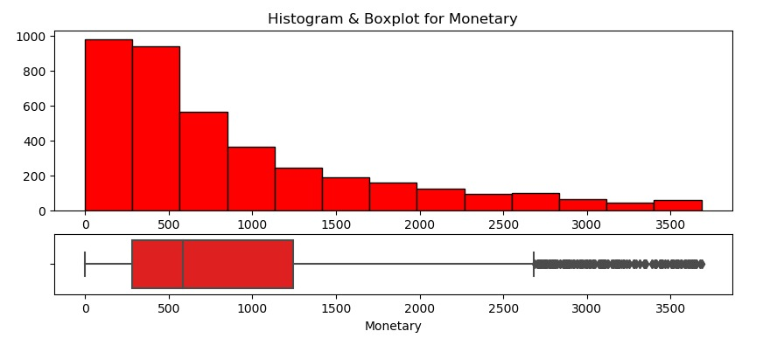
Methodology – Module 1
The interquartile range is the difference between the first(Q1) and third quartiles(Q3). It can be mathematically represented as
IQR = Q3 - Q1.
The interquartile range is a robust statistic because it is not distorted by outliers like the average (or mean).

Slide 11
Methodology – Module 1
The Hopkins statistic is a way of measuring the cluster tendency of a data set. It belongs to the family of sparse sampling tests.
We used Hopkins statistic here to measure cluster tendency -
If the value is between 0.01,…,0.3 , the data is regularly spaced.
If the value is around 0.5 , it is random.
If the value is between 0.7,…,0.99 , it has a high tendency to cluster.
After applying this technique, cluster tendency of 0.95 was resulted.

Slide 12
Methodology – Module 1
Now, once we know the dataset can be clustered, so next we computed what was the ideal number of clusters that should be formed.
For this we used Silhouette Analysis.
Silhouette analysis can be used to study the separation distance between the resulting clusters. The silhouette plot displays a measure of how close each point in one cluster is to points in the neighboring clusters and thus provides a way to assess parameters like number of clusters visually.
Finally, it gives a silhouette score for number of clusters to be formed.

Slide 13
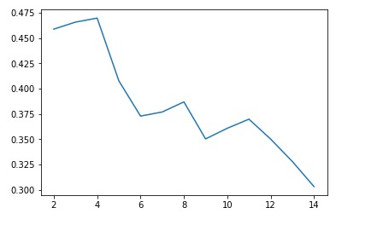
Methodology – Module 1
After plotting and analysing all silhouette scores, ideal number of clusters to be 4 was decided.

Slide 14
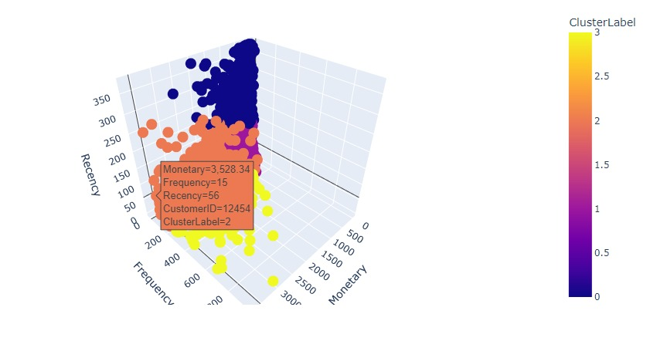
Methodology – Module 1
We now applied K-Means algorithm for a k value equal to 4

Slide 15
Methodology – Module 2
Separate clustering was done for Recency, Frequency and Monetary for first 3 months by applying K-Means separately on each feature.
Summation of cluster labels for Recency, Frequency and Monetary was done to find RFM value for each customer.
After computing RFM values, customers were distributed into 3 segments based of following rules:
0 to 2: Low Value
3 to 4: Mid Value
5+: High Value

Slide 16
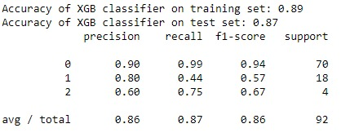
Methodology – Module 2
Now we calculated customer-wise revenue for the next Six months and applied K-Means clustering on it.
Clustering helped us to create three clusters (low-value, mid-value and high-value)
Now we added these cluster labels to our dataset to make it a labelled dataset.
Then we applied XGBoost classifier on this labelled dataset to predict the segment of the customer.

Slide 17
Advantages
Segmenting customer base helps in better understanding the customers and thus personalizing marketing and communication for each segment.
This is very beneficial because people tend to respond better and be of greater value to the business when they feel their needs and interests are being specifically addressed.
Further this enables us to calculate a customers lifetime value prediction.
Higher Customer Retention and easy maintenance of customer relationship

Slide 18
References
1] Sari, Juni Nurma, et al. "Review on customer segmentation technique on ecommerce." Advanced Science Letters 22.10 (2016): 3018-3022.
2] A. Banduni, Ilavendhan. "Customer Segmentation using Machine Learning" International Journal of Creative Research Thoughts (IJCRT) Volume 7, Issue 2:(116-112)
3] Bhade, Kalyani, et al. "A Systematic Approach to Customer Segmentation and Buyer Targeting for Profit Maximization." 2018 9th International Conference on Computing, Communication and Networking Technologies (ICCCNT). IEEE, 2018.
4] Christy, A. Joy, et al. "RFM ranking–An effective approach to customer segmentation." Journal of King Saud University-Computer and Information Sciences 33.10 (2021): 1251-1257.
5] Bulletin of the Transilvania University of BraşovSeries V: Economic Sciences • Vol. 9 (58) No. 2 – 2016
6] Monil, Patel. “Customer Segmentation Using Machine Learnin.” International Journal for Research in Applied Science and Engineering Technology 8.6 2104–2108. Web.

